Slide 1
GRI-S : Infrastructures
The Union list of projects of common interest
European Commission
DG Energy
Internal Market I: Networks and Regional Initiatives

Slide 2
The TEN-E Guidelines & CEF
CO2 transport
E-highways
Smart grids
Criteria / CBA
248 PCIs
Accelerated permit granting
Regulatory measures
EU financial assistance
Notes:
2
In order to tackle this investment challenge, Regulation on trans-European energy infrastructures adopted and in force since mid-May 2013.
Connecting Europe Facility, providing financial framework, expected to enter into force by December.
Regulation includes the following elements:
New, dynamic way to identify projects of common interest (PCI). Once identified, these may benefit from the following measures:
Accelerated permit granting (3.5 years time limit and one-stop shop)
Improved regulatory treatment for cross-border projects (cross-border cost allocation, appropriate incentives)
Rules to grant financial aid under the Connecting Europe Facility (grants and financial instruments)
We have come a long way – together with TSOs and project promoters, Member States, regulators, ENTSOs, ACER and the Commission, we have identified a list of 248 energy infrastructure projects of common interest, which are crucial to integrate and make use of a single European energy market!

Slide 3
Timeline of first PCI identification process
ENTSOs (G/E)
Project promoters
NRAs (G/E)
EC
Regional Groups
ACER (G/E)
Regional Groups
Prepare TYNDPs for gas and electricity
Submit projects from TYNDP
Criteria
CBA
Check application of criteria
Cross-border relevance
Evaluate projects
Adopt draft regional lists
Opinion
Cross-regional consistency
Adopt final regional lists
Adopt Union list of PCIs
Date
July
2012
Early
2013
January
- May 2013
17 July
2013
24 July
2013
14 October
2013
Consultation of stakeholders in May/June 2013
Environmental NGOs in Brussels
Gas stakeholders at Gas Coordination Group
Electricity stakeholders at Florence Forum

Slide 4
The first Union PCI list - gas
107 projects of common interest
Total length: about 19.500 km
Total additional import capacity: 103 bcm
Total investment costs: about 53 bn EUR
North-South interconnections West: 27 PCIs
North-South interconnections East: 53 PCIs
BEMIP: 15 PCIs
Southern Gas Corridor: 12 PCIs
Notes:
In gas, 107 PCIs, with a total length of about 19.500 km, a capacity of 103 bcm, with total investment costs of about 53 bn EUR.
More than half are located in Eastern Europe, with 53 PCIs in the Eastern region plus 12 PCIs in the Southern Corridor region, the rest in Western Europe and the BEMIP region.
7 PCIs in oil in Central Europe.

Slide 5
Impact of PCIs on the Security of Supply
Compliance with the N-1 infrastructure standard – before and after (2022)
no
yes
Reference: Art. 9 of Regulation No 994/2010
Source: Commission
Notes:
5

Slide 6
PCIs support access to new resources
Number of supply sources a country may potentially access to through infrastructure (at least 5% share) – before and after (2022)
1
2
3
4
5
6
7
Access to LNG
Supply Sources: Azerbaïdjan (new source), Algeria, Lybia, Norway, Russia, National Production, LNG (one source)
do not prejudge any commercial contracts
Source: ENTSO-G TYNDP 2013, Commission
Notes:
Also, the PCIs will allow the Union to diversify its gas sources and end single source dependency of several Member States.
All Member States will have access to at least 2 supply sources, except for Cyprus with indigenous resources.
6

Slide 7
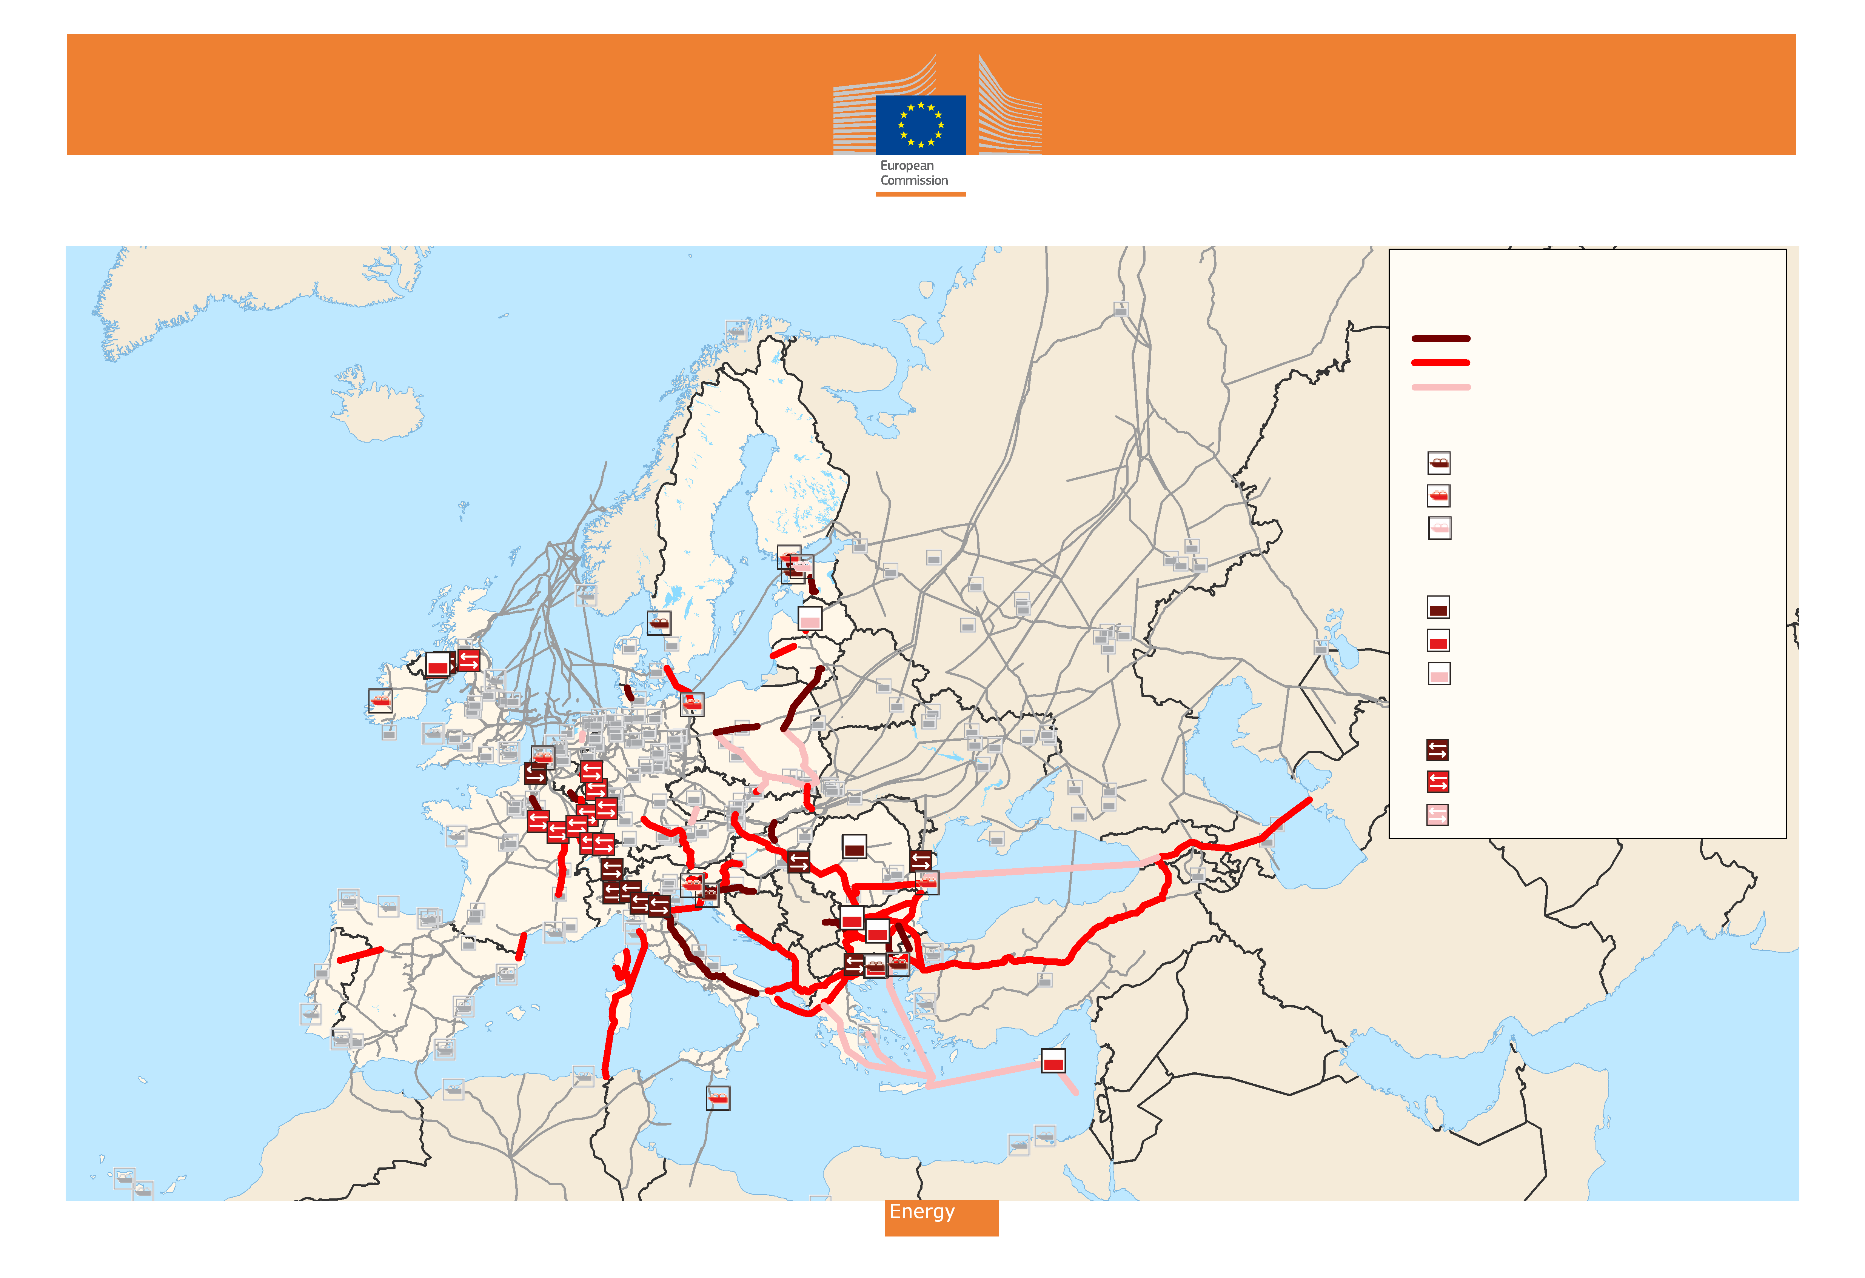
Energy Infrastructure - Natural Gas
Projects of Common Interest:
Gas Pipelines
Commissioning date < 2017
Commissioning date 2017 to 2020
Commissioning date > 2020
Terminals for Liquefied Natural Gas (LNG)
Commissioning date < 2017
Commissioning date 2017 to 2020
Commissioning date > 2020
Storage Facilities
Commissioning date < 2017
Commissioning date 2017 to 2020
Commissioning date > 2020
Reverse Flows
Commissioning date < 2017
Commissioning date 2017 to 2020
Commissioning date > 2020
Source: © Eurogeographics for the administrative boundaries;
© PLATTS for the underlying energy network.
Cartography: European Commission, Energy DG, June 2013

Slide 8

Accelerate permit granting
Priority
  Most preferential treatment in Member States
  Streamlining of EA procedures
Competent Authority to manage
permit granting process
3 and a half years time limit for the
permit granting decision
Increased transparency and
enhanced public participation
ONE
STOP
SHOP
Notes:
Designate functioning one-stop shops which can deliver more efficient permitting procedures – the Commission delivered on the streamlining guidance in summer, it is now up to the Member States to implement!
TSOs and authorities to integrate the public effectively and discuss early on with the citizens

Slide 9
Regulatory framework - measures
Methodology to be developed by the ENTSOs
ACER opinion / Commission approval
ENTSOs to apply CBA
in TYNDP
Request by project promoters (incl. CBA)
NRAs to issue joint decision within 6 months
if no agreement, ACER steps in
ACER to facilitate best practices
NRAs to publish incentive methodologies
possible Guidelines by the Commission
Energy system-wide cost-benefit analysis
Cross-border cost allocation
Long-term incentives for investment
Notes:
Develop a more advanced cost-benefit analysis and to elaborate the next generation of TYNDPs – ENTSOs, in cooperation with ACER
Discuss methodologies for cross-border cost allocation and deliver on appropriate investment incentives – national regulators and ACER

Slide 10

Financing – Connecting Europe Facility 2014-2020 – EUR 5,8 bn
Eligibility criteria:
  Grants for studies and financial instruments – available to all PCIs
  In exceptional cases, grants for works for PCIs where:
      CBA shows positive externalities
      Commercially not viable
      Cost-allocation decision done
No financial assistance for oil projects
No grants for works for hydro-pump storages and projects exempted from TPA or tariff regulation
Notes:
10

Slide 11

Thank you for your attention

Slide 12
Adoption of the delegated act
European Commission
European Parliament & European Council
[European Parliament & European Council]
Adopt Union list of PCIs
No objection expressed within 2 months?
Notification necessary
[Extended period of 2 month on request of European Parliament or Council]
Delegated Act is adopted:
Delegated Act enters into force (+20 days):
Delegated Act enters into force (+20 days):
Date
14 October
2013
3 January
2013
6 March
2014
Notes:
Article 3:
Establishment of
Union List by
adoption of a
delegated act
Article 16:
Process for adoption of a
delegated act

